Slide 1
CommonWell Health Alliance
“Interoperability for the Common Good”
Scott Stuewe
Director, Cerner Network
Chair, CommonWell Health Alliance Program Management Committee

Slide 2








Interoperability
Interoperability occurs when information flows freely across organizational, vendor and geographic barriers.
“In 2013, health information exchange among physicians was relatively low: 4 in 10 (39 percent) reported they electronically share data with other providers, but only 14 percent electronically share data with ambulatory care providers or hospitals outside their organization” http://www.hhs.gov/news/press/2014pres/08/20140807a.html
What is the patient’s experience today?
Notes:
Interoperability is the ability for information that can be used to advance patient care to move between health care entities regardless of the technology platform in place or the location where care was provided. Interoperability occurs when information flows freely across organizational, vendor and geographic barriers.
The entire health care industry will benefit from interoperability, but ultimately, patients stand the most to gain from interoperability. Health care professionals can provide better care to the patient by being able to see the different care touch points that make up the patient’s medical history. Past problems, allergies, medications, immunizations, lab results and more help the provider make an informed decision about patient care, and remove the burden from the patient from having to carry physical copies of his records from doctor’s office to doctor’s office, or more challenging, rely on memory of past treatments to provide context to his care givers.
Intraoperability – connecting different organizations that use the same technology platform – only solves a piece of the problem. Imagine if your Samsung cell phone could only talk to other Samsung phones, but not to an Apple iPhone. That would be an example of intraoperability. When providers only have access to intraoperable networks, they’re getting an incomplete picture of the patient’s care.

Slide 3
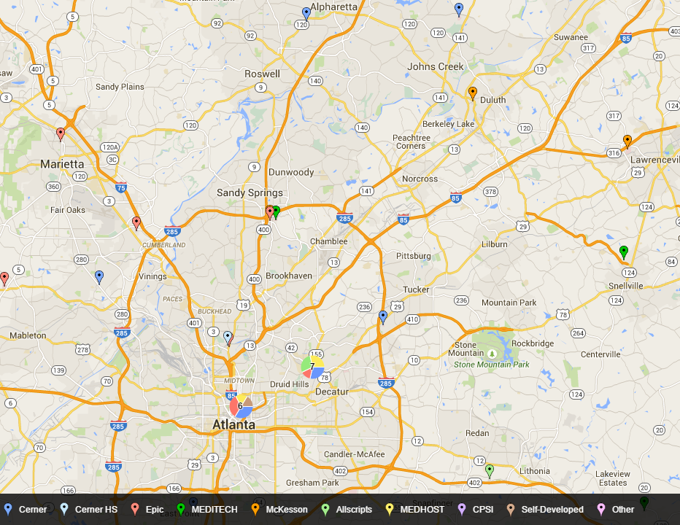

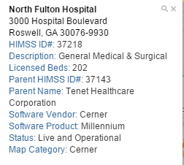

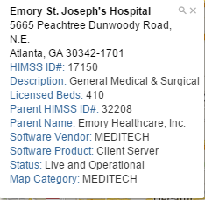

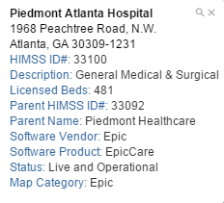


Slide 4
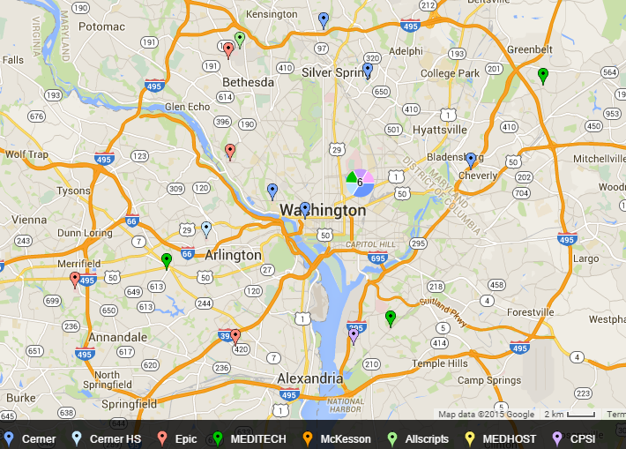

Slide 5

Hospital
Specialist
Primary Care
Registry
“Connect
my Community”
(outreach)

Slide 6


“Find the
Patient’s
Records”
Hospital
Specialist
Primary Care
Therapy
Low value
My Competitors
Far Away

Slide 7
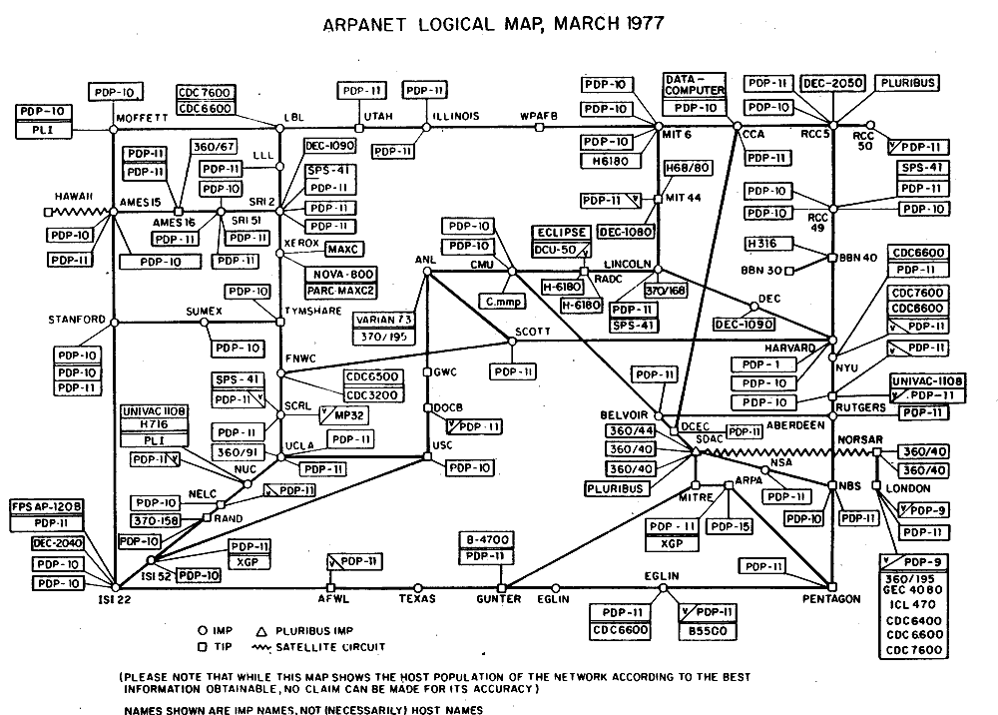
Imagine the internet without Google…

Slide 8



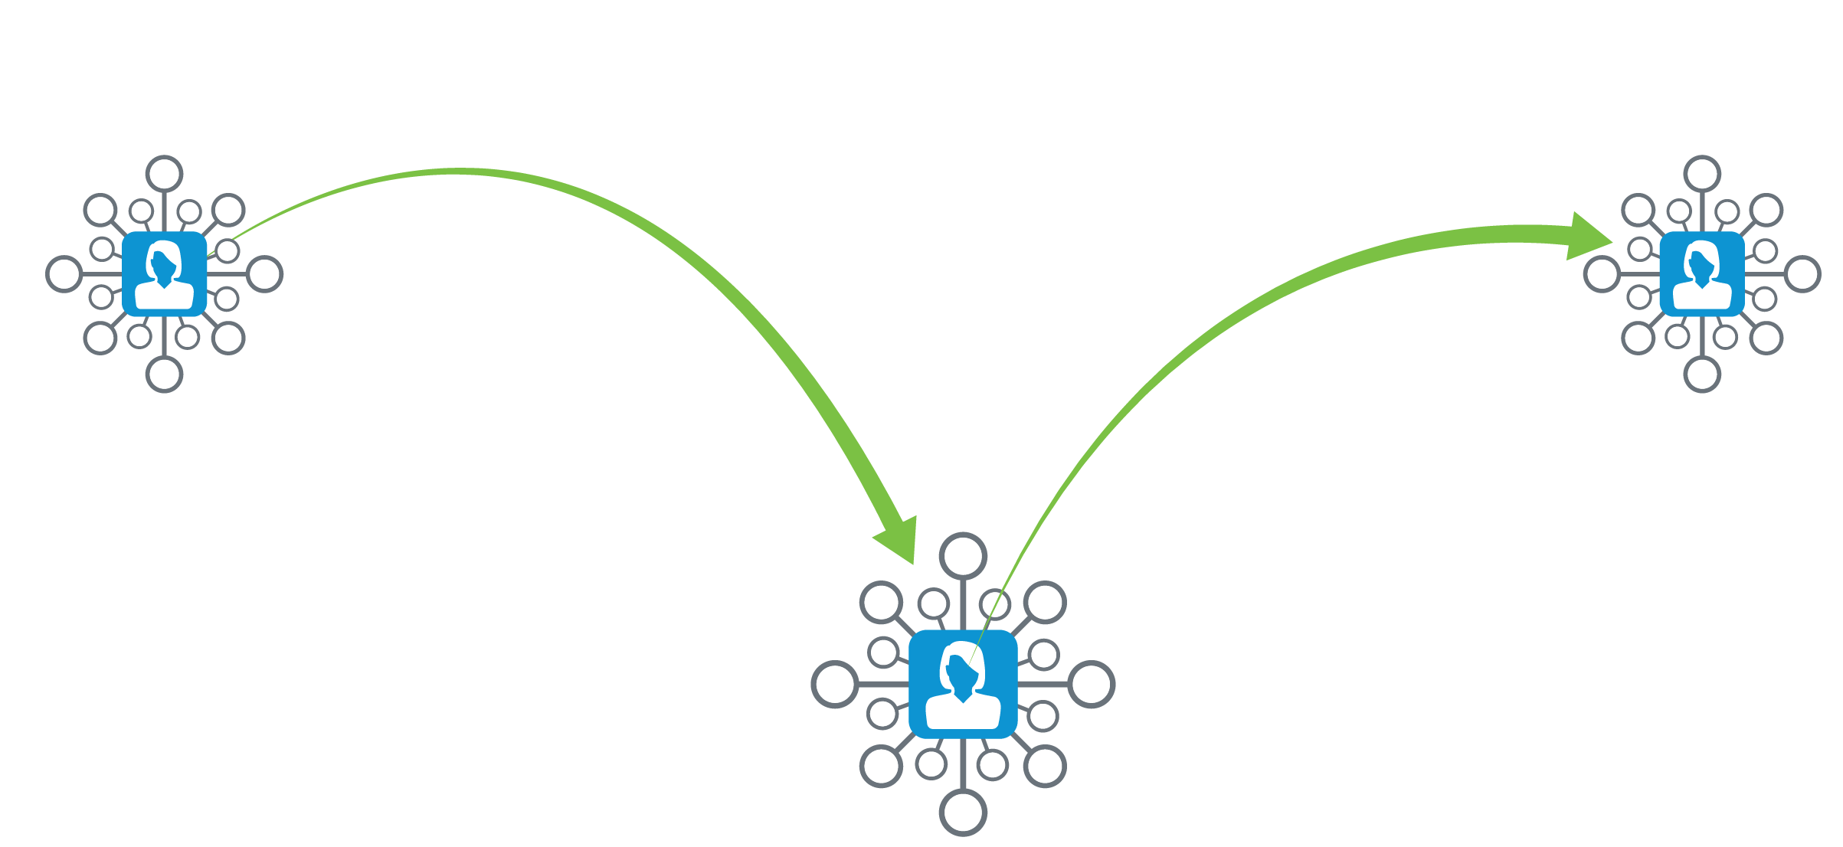


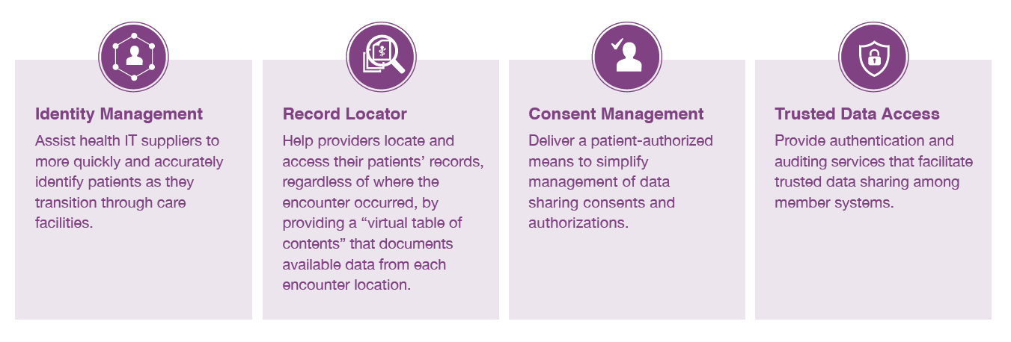
National Health Data Exchange

Slide 9


CommonWell Health Alliance Introduction
May 2012 BPC Meeting
March 4, 2013 at HIMSS13
Farzad Mostashari
challenge to the group:
“you need to solve this problem yourselves”
Notes:
For background/reference:
It was at a May 2012 BPC meeting, in response to observations by Farzad Mostashari, MD, ScM | National Coordinator for Health IT, HHS; Aug. 7, 2013, that the federal government was legally constrained from implementing an official “National Patient Identifier,” that the initial impulse to create CommonWell emerged. Farzad’s challenge to the group that “you need to solve this problem yourselves” was a significant motivation in the launch of CommonWell. Cerner’s Dr. David McCallie and RelayHealth’s Arien Malec first started discussions following this meeting, with the official announcement of the CommonWell Health Alliance occurring on March 4, 2013 at HIMSS13 in New Orleans.
From there we fast forward a few months to March 4, 2013, when 5 competitors sat on stage together at HIMSS and announced that they would work together to improve the way healthcare records are shared among a patient’s providers. The made a commitment to create the same kind of industry collaboration that enabled interoperability in banking and cellular phone service. The agreed to build the ability to share clinical documents into their applications.

Slide 10
Our Vision
We are an independent, not-for-profit trade association open to all HIT suppliers and others devoted to the simple notion:
That health data should be available to individuals and providers regardless of where care occurs and;
That provider access to this data must be built-in to HIT at a reasonable cost for use by a broad range of health care providers and the people they serve
Notes:
More specifically, they built an independent not-for-profit trade association – CommonWell Health Alliance - open to all HIT suppliers and others devoted to the simple notion that health data should be available to individuals and providers regardless of where care occurs and that provider access to this data must be built-in to HIT at a reasonable cost for use by a broad range of health care providers and the people they serve
In short, the Alliance aims to change the public’s perception about the availability of their health data by providing the first nationwide, patient directed network of networks to make this a reality.

Slide 11








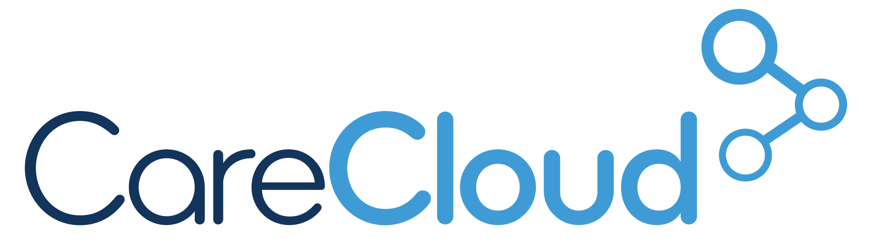

















CommonWell Health Alliance Members
Interoperability for the Common Good
70%+
of acute EHR
24%+
of ambulatory EHR
Market leaders in lab, long-term care, retail pharmacy and more
Founding Members
Contributor Members
General Members
Source: SK&A, a Cegedim Company and KLAS
“EHR Vendor Market Share by Physician Size” SK&A. January 2015.
© 2014 KLAS Enterprises, LLC. All rights reserved. www.KLASresearch.com
Initial Service Provider

Slide 12


CommonWell Health Alliance for Record Location and Retrieval
CommonWell Services
Consent Management
Identity Management
Record Locator
Document Query
Document Retrieval
Community Hospital
Long-Term Care
Lab
Trusted Data Access
Physician
Office
IDN
Notes:
Remember this visual from the Challenges section?
[Note: Orange words relate to the orange arrows. Blue words relate to the blue arrows.]
Given the synopsis of our progress, now let’s talk about the services that CHA will provide.
The initial launch included the these core services:
Consent Management: Deliver a patient-authorized means to simplify management of data sharing consents and authorizations.
Identity Management: Provide a way for HIT suppliers to quickly and accurately identify patients as they transition through care facilities.
Record Locator: Help providers locate and access their patients’ records, regardless of where the encounter occurred, by providing a “virtual table of contents” that documents available data from each encounter location.
Query & Retrieve: CommonWell is not a data repository. We are merely a broker, making document query and retrieval quicker and more seamless.
Trusted Data Access: Provide authentication and auditing services that facilitate trusted data sharing among member systems.
What is unique about our approach is that in addition to organization registration, which is what HIEs do, we have a much more active and engaged enrollment and consent validation process that leads us to have stronger patient matching – which is happening at the national level, not just at the organization or HIE level
CommonWell will provide a more streamlined way to support record query and retrieval, putting the patient at the center of the decision and of the information. You can almost think of this as an ATM model where you can withdraw cash from any bank’s ATM regardless of where your account resides.
Value: information is shared quickly and accurately
CommonWell is not a data repository. We are merely a broker, making document query and retrieval quicker and more seamless.

Slide 13
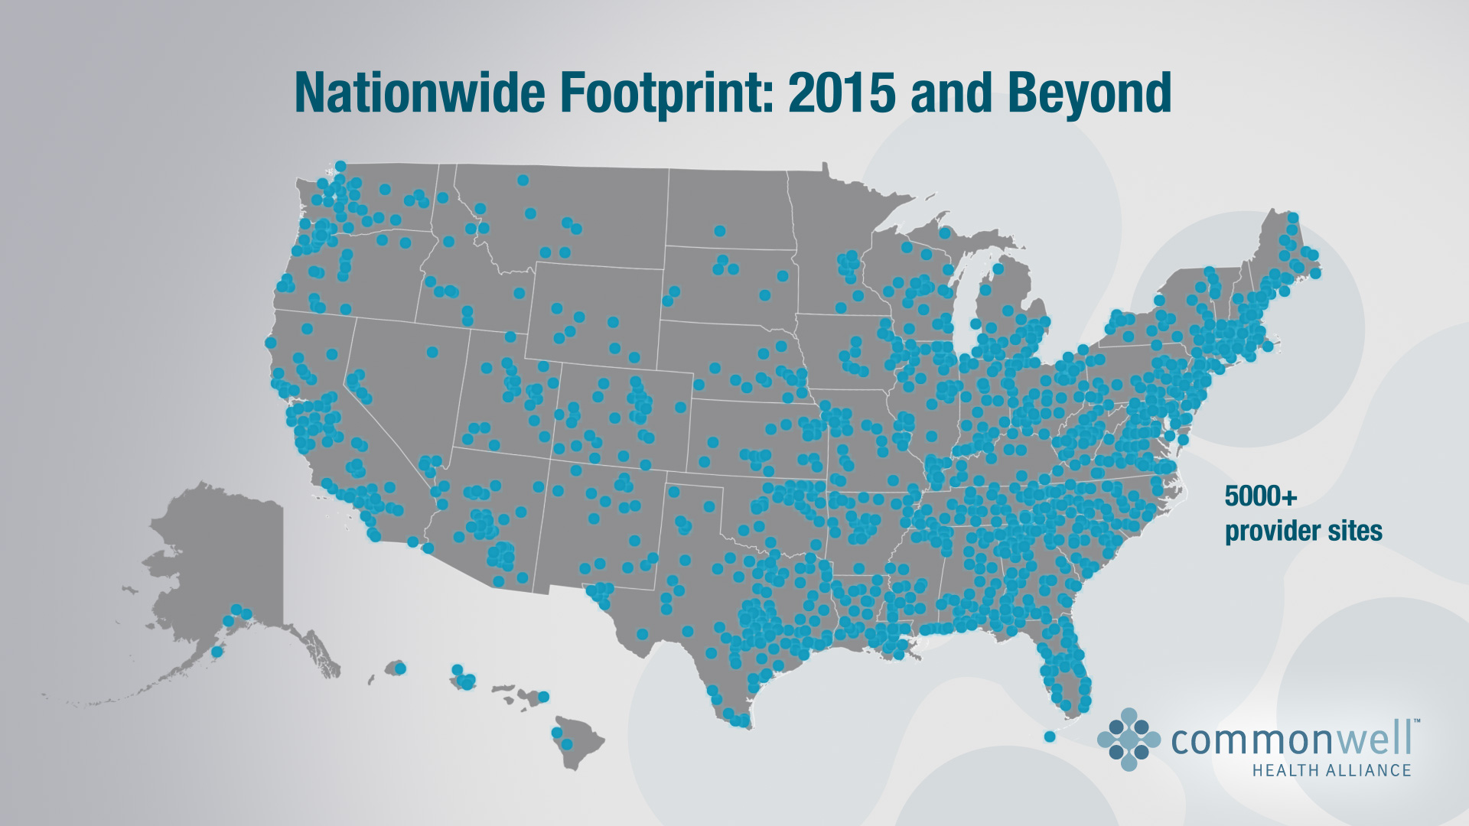

Slide 14






Together we can accomplish great things
Notes:
Together we can accomplish great things. Health care is personal and it is too important to stay the same.
(Speaker note: option to reference your family in the photos (can replace the bottom-middle image) – i.e. “This is my family, and I believe in a better system, for them, that’s why I’m with Cerner)

